Slide 1
Utilizing software for risk management
Support for IT Project Management - Labaratory
Alexandr Pimenov 282611
02.06.2026

Slide 2
Risk management baseline used for evaluation
Identify
Analyze
Track
Control
Plan
Risk register
Central document/database for identified risks, owners, probability and impact analysis, response plans, status and lifecycle control.
Risk matrix
Qualitative prioritization mechanism that maps likelihood/probability against impact/severity and communicates priority visually.
Risk responses
Threat responses: avoid, mitigate/reduce, transfer, accept.

Slide 3
User needs mapped to software functionalities
User need
Functionality
Single source of truth
Central Risk Register: centralized database capturing risk titles, causes and effects.
Consistent grouping and filtering
Risk Classification: group and filter risks using WBS/RBS or project categories.
Clear accountability
Risk Ownership: assign specific owners to individual risks for clear accountability.
Objective prioritization
Qualitative Assessment: rank risks by evaluating probability and impact.
Fast visual communication
Visual Risk Matrix: display risk exposure visually on a color-coded grid.
Practical response logic
Response Strategies: assign strategies such as mitigate, avoid or exploit to risks.
Executable mitigation work
Action Workflow: convert response strategies into executable, tracked work tasks.
Continuous control
Status & Triggers: monitor statuses, review dates and risk triggers.
Quantified exposure
Quantitative Analysis: numerical schedule and cost risk modeling.
Management visibility
Dashboards & Reports: provide management visibility through clear reporting.

Slide 4
FUNCTIONALITY SPECIFICATION
Functionality table - register, structure and assessment
Functionality
Input
Output
Description
MoSCoW
Central Risk Register
Risk title, cause, effect, project, date, owner, status
Unique record in a central register
Single, auditable risk database.
Must
Risk Classification
WBS/RBS code, category, deliverable, discipline
Filters, roll-ups and category reports
Links risk to project structure.
Must
Risk Ownership
Owner, role, backup, escalation path
Assigned owner and accountability trail
Makes monitoring accountable.
Must
Qualitative Assessment
Probability, impact, thresholds, pre/post values
P × I score, priority and rating
Ranks exposure consistently.
Must
Visual Risk Matrix
P/I score, scales and color thresholds
Heat-map position and color priority
Shows urgency visually.
Should

Slide 5
Functionality table - response, control and reporting
Functionality
Input
Output
Description
MoSCoW
Response Strategies
Risk type, score, constraints, possible strategy
Chosen response for threat or opportunity
Selects treatment logic.
Must
Action Workflow
Tasks, owners, due dates, cost, approvals
Tracked actions, reminders, escalation
Turns response into work.
Could
Status & Triggers
Status, trigger criteria, review dates, actual events
Alerts, updates, escalation history
Keeps register live.
Must
Quantitative Analysis
Schedule/cost model, distributions, scenarios
P-curves, contingency, risk-adjusted dates/costs
Models numerical exposure.
Should
Dashboards & Reports
Register fields, scores, ownership, action data
Dashboards, exports, management reports
Supports management decisions.
Must

Slide 6
List of programs analyzed
Computer program
Type
Producer / provider
Price
Active Risk Manager
Web, programme and enterprise risk platform
Riskonnect
Not listed
Safran Risk Manager
Secure web-based risk management application
Safran Software Solutions
Not listed
RiskyProject Professional
Standalone desktop application and Microsoft Project add-in
Intaver Institute
$979 yearly
Oracle Primavera Cloud Risk Management
Cloud-based risk module inside Primavera Cloud
Oracle
5-user annual starter pack at US$7,800
monday work management
Web work-management platform
monday.com
Basic €9, Standard €12 and Pro €19 per seat/month
Google sheets
Web collaborative spreadsheet platform
Google LLC
From 7$ to 22$ per user per month

Slide 7
Functionalities comparison matrix - register and assessment
Program
Central
register
Classification
Ownership
Qualitative
assessment
Visual risk
matrix
Active Risk Manager
Native register
Categories
Native owner fields
Native scoring
Native heat maps
Safran Risk Manager
Native common database
Native categories
Native roles & status
Native scoring
Native dashboards/matrix
RiskyProject Professional
Native register
Task
WBS links
Native owner field
Native scoring
Native configurable matrix
Oracle Primavera Cloud
Native register
Links to projects
Native ownership
Native scoring
Native risk matrix
monday work management
Template board
Custom columns
People column
Formula scoring
Configurable dashboard
Google sheets
Template sheet
Columns/filters
Custom column
Formula scoring
Template/conditional format
Good: native / strong
Medium: configurable / partial
Bad: missing / manual only

Slide 8
COMPARISON MATRIX
Functionalities comparison matrix - response, control and reporting
Program
Response
strategies
Action
workflow
Status &
triggers
Quantitative
analysis
Dashboards &
reports
Active Risk Manager
Native/configured strategies
Native workflow
Status only
Probabilistic analysis
Native reports
Safran Risk Manager
Native strategies/actions
Native workflow
Triggers and history
Probabilistic analysis
Native dashboards
RiskyProject Professional
Mitigation planning
Native action plan
Triggers and history
Probabilistic analysis
Reports; desktop oriented
Oracle Primavera Cloud
Threat/opportunity responses
Response actions + activity links
Status only
Probabilistic analysis
Native dashboards
monday work management
Template/configured
Tasks + automations
Status/ manual automations
Formula
Native dashboards
Google sheets
Configured plans
Rows + automations
Alerts automation
Formula
Native dashboards
Good: native / strong
Medium: configurable / partial
Bad: missing / manual only

Slide 9

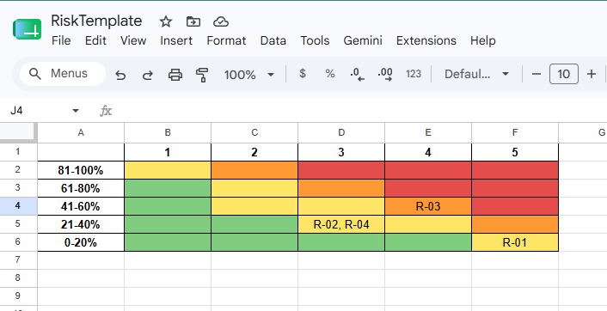
Chosen software: Google sheets
Best team fit
Project team wanting forms, formulas, reports and dashboards with low transition friction.
High-confidence capabilities
• Automated risk intake through forms
• Formulas and conditional formatting for scoring
• Dashboards for high-priority risks
• Many risk-register and matrix templates
Main limitations
Practical for tracking, but advanced risk-method support is template/formula driven rather than native.
Cost / pricing note
Rich free version for personal use. From 7$ to 22$ per user per month for business. Comes in google suit for business with a lot of additional features besides sheets (for example google disk space)

Slide 10
Why Google sheets?
Free access without demo requests
Enough for lab to edit Risk register and review 5x5 Risk matrix
Familiar to students

Slide 11
Preparation
Go to sheets.new
File > Import > Pick the downloaded template
Observe two sheets: Risk Register, 5x5 Risk matrix

Slide 12
Practical tasks (Google sheets):
In the provided .xlsx template delete the existing risks. Add 10 risks.
For each risk add probability and impact.
Show how this risks are displayed in 5x5 matrix and interpret what it means.

